Slide 1
Color Image Processing Using Open CV

Slide 2
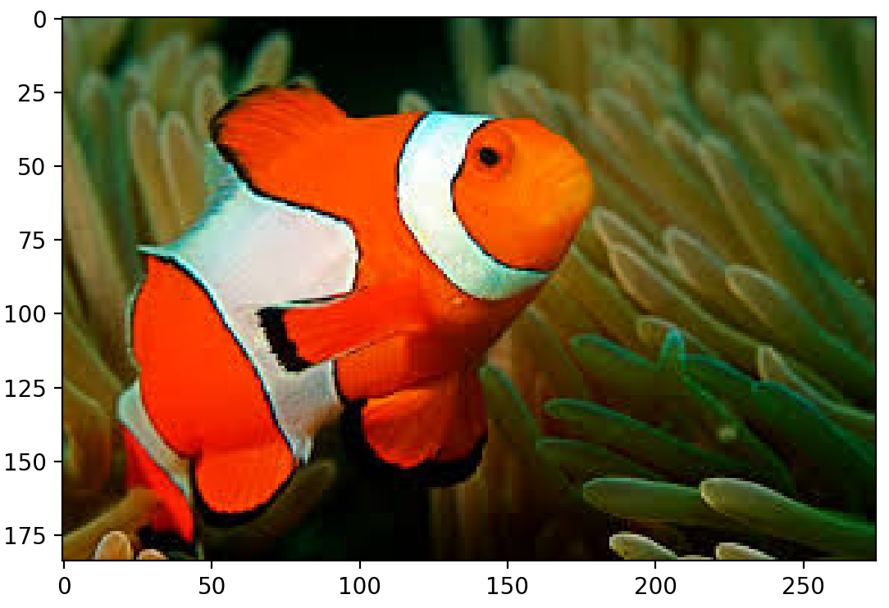

Slide 3
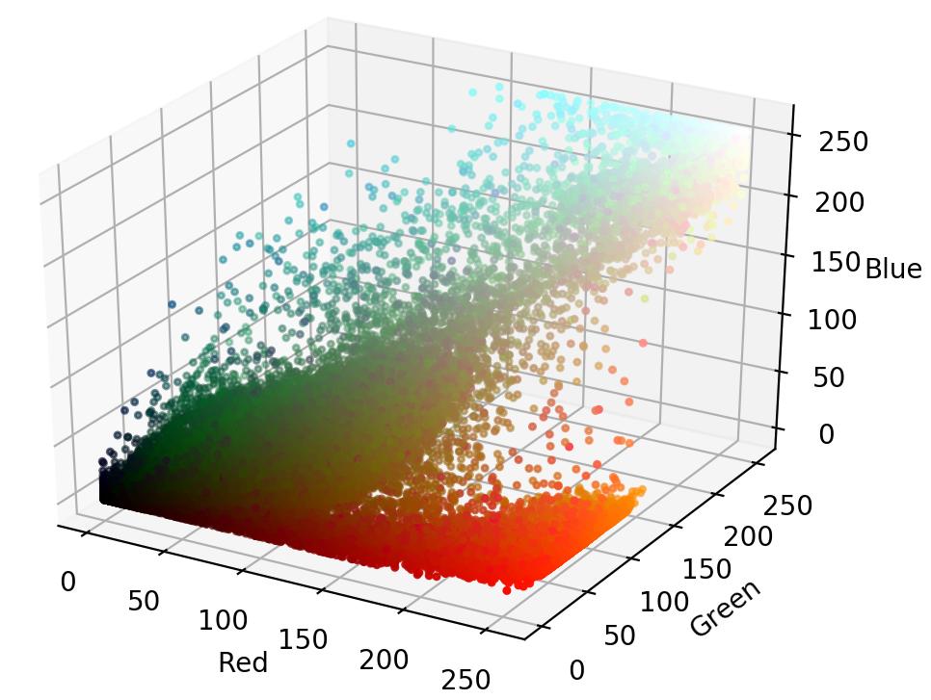
3D Scatter plot of Nemo in RGB Model

Slide 4
HSI Color Model
Hue (dominant colour seen)
Wavelength of the pure colour observed in the signal.
Distinguishes red, yellow, green, etc.
More the 400 hues can be seen by the human eye.
Saturation (degree of dilution)
Inverse of the quantity of “white” present in the signal. A pure colour has 100% saturation, the white and grey have 0% saturation.
Distinguishes red from pink, marine blue from royal blue, etc.
About 20 saturation levels are visible per hue.
Intensity
Distinguishes the gray levels.

Slide 5
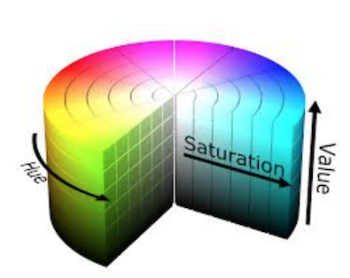
HSV Color Model

Slide 6
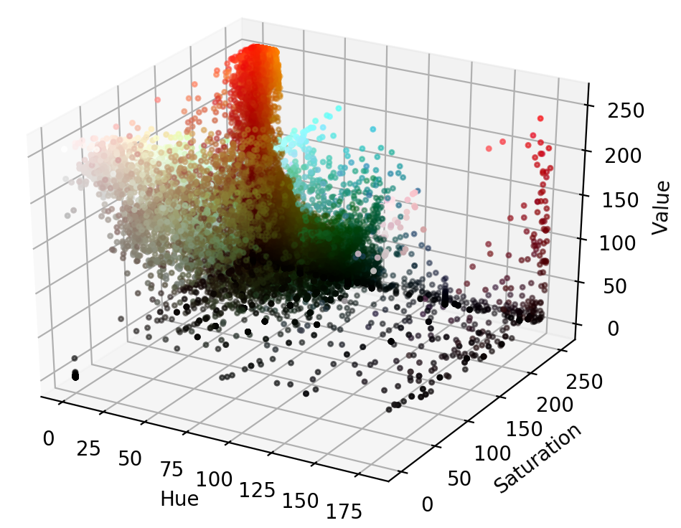
3D Scatter plot for HSV color model

Slide 7
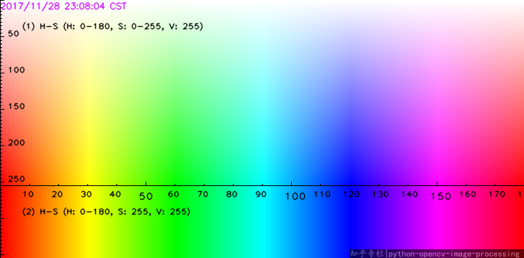

Slide 8
The x-axis represents Hue in [0,180), the y-axis1 represents Saturation in [0,255], the y-axis2 represents S = 255, while keep V = 255.
To find a color, usually just look up for the range of H and S, and set v in range(20, 255).
To find the orange color, we look up for the map, and find the best range: H :[10, 25], S: [100, 255], and V: [20, 255]. So the mask is cv2.inRange(hsv,(10, 100, 20), (25, 255, 255) )

Slide 9
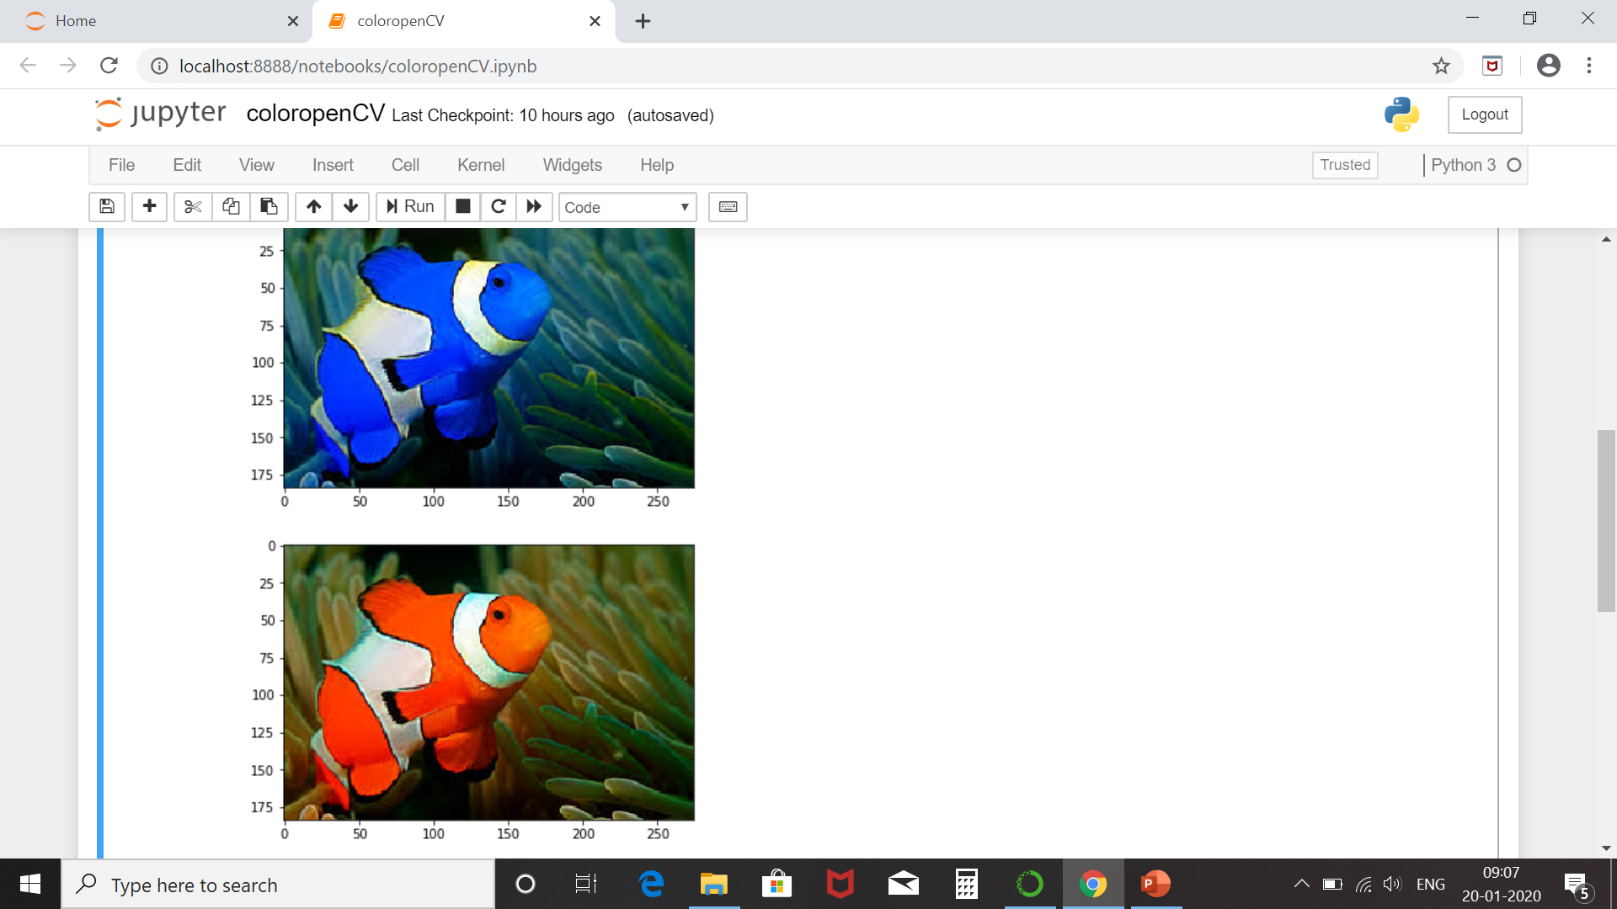

Slide 10
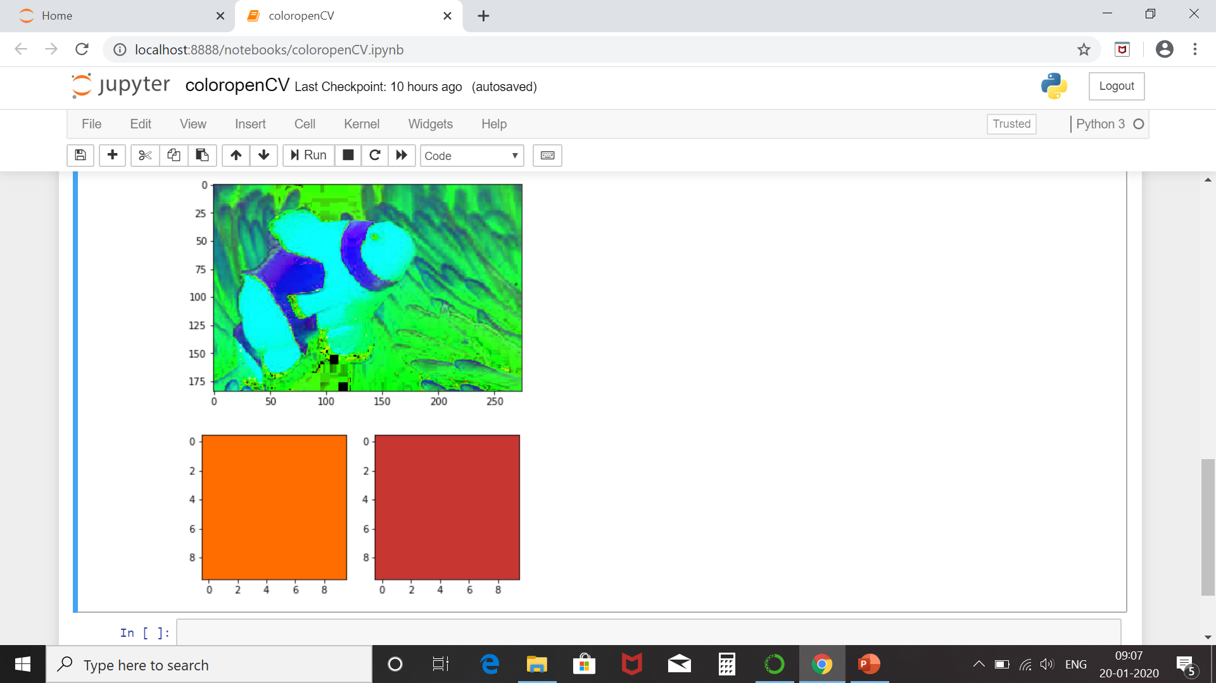

Slide 11
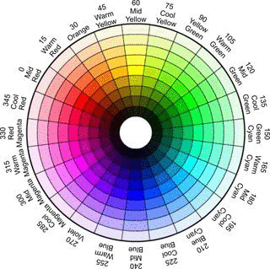

Slide 12
numpy.full(shape, fill_value, dtype = None, order = ‘C’) : Return a new array with the same shape and type as a given array filled with a fill_value.
shape : Number of rows
order : C_contiguous or F_contiguous
dtype : [optional, float(by Default)] Data type of returned array. fill_value : [bool, optional] Value to fill in the array.

Slide 13
cv2.bitwise_and(src1, src2[, dst[, mask]])
Parameters:
src1 – first input array or a scalar.
src2 – second input array or a scalar.
src – single input array.
value – scalar value.
dst – output array that has the same size and type as the input arrays.
mask – optional operation mask, 8-bit single channel array, that specifies elements of the output array to be changed.

Slide 14
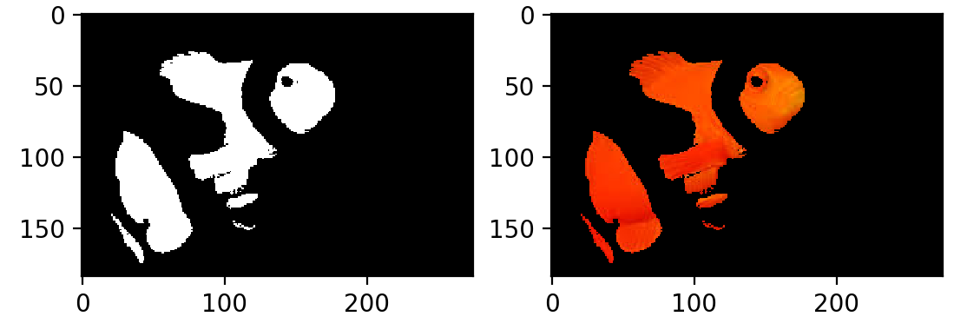

Slide 15
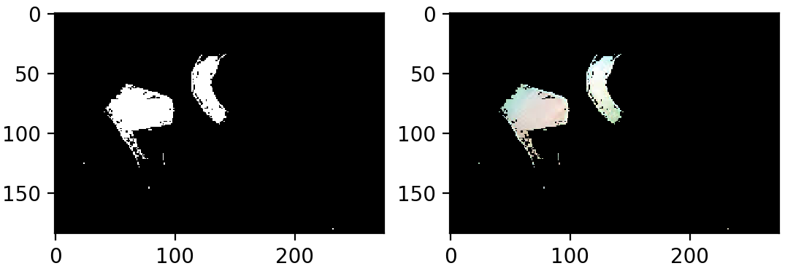

Slide 16
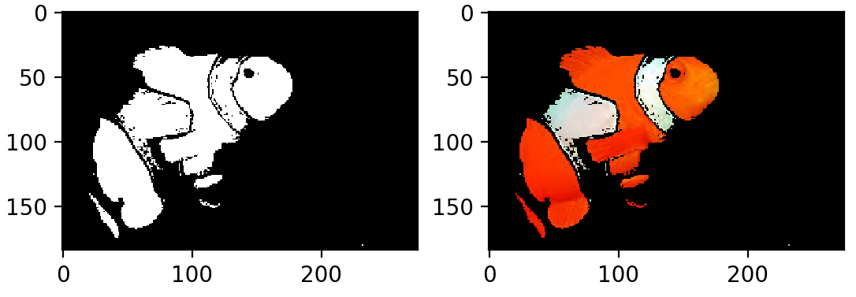

Slide 17
